Slide 1
SMART SIGNS FOR IMPROVED ROAD SAFETY

Slide 2
PRESENTED BY:-
MAYANK RAI-1704523
PRAGYA-1704529
PRATEEK TIWARY-1704533
PRITIKA RANJAN-1704535
RUCHIKA DUBEY-1704547

Slide 3
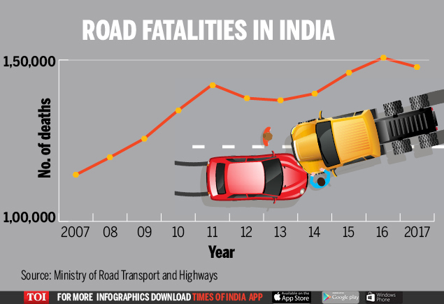
INTRODUCTION
Accidents are quite common on roads in present roadways system.
Traffic collisions in India are a major source of deaths, injuries and property damage every year.

Slide 4
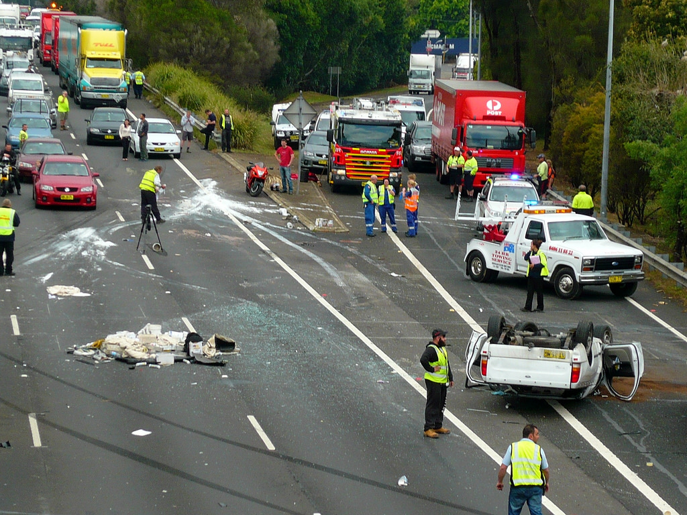
In 2015, according to NGO 'Indians for Road Safety',one person dies every 4 minutes in roads collisions in India.
Due to accident,passengers stuck in traffic behind all the debris has to waste much of their valuable time.
Government of India has applied diffrent schemes to control the situation,but these attempts have yet to show any significant effects .

Slide 5
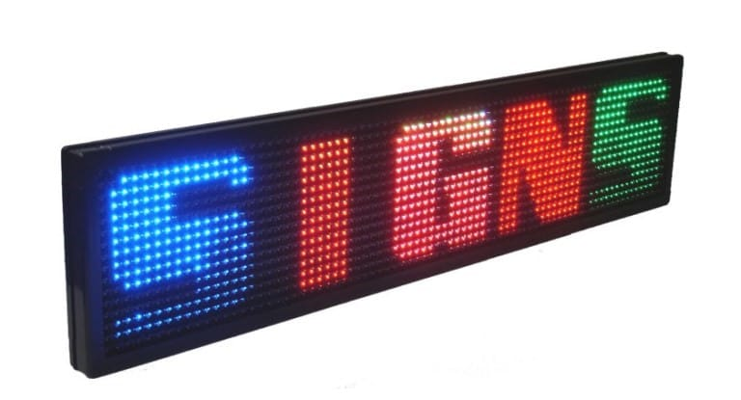
OBJECTIVE
In present System the road signs are Static,which is one of the reason behind accidents.
We can consider some cases when there are some road diversions due to heavy traffic or due to accidents then we can change the road signs accordingly if they are digitalized.

Slide 6
This project proposes a system based on IOT (Internet OF Things) which has digital sign boards on which the signs can be changed dynamically.
By using it, we can get the weather or road condition reports based on which we can set the road sign to particular area.
If there is rainfall then the roads will be slippery and the the signs will display the same.
Also,static signs are not very eye-catching and are ignored by the people, it increases the chances of accidents.

Slide 7
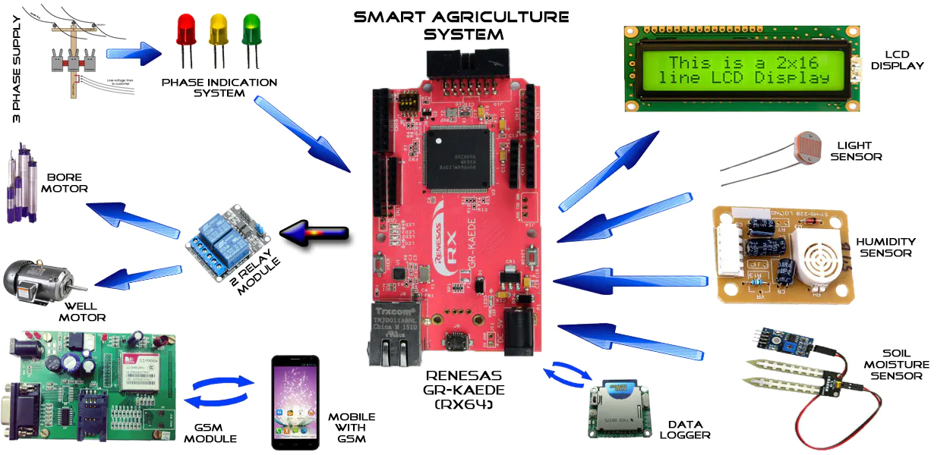
HARDWARE REQUIREMENTS

Slide 8
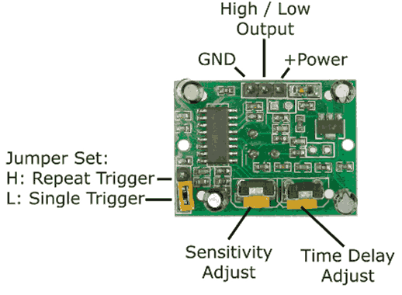
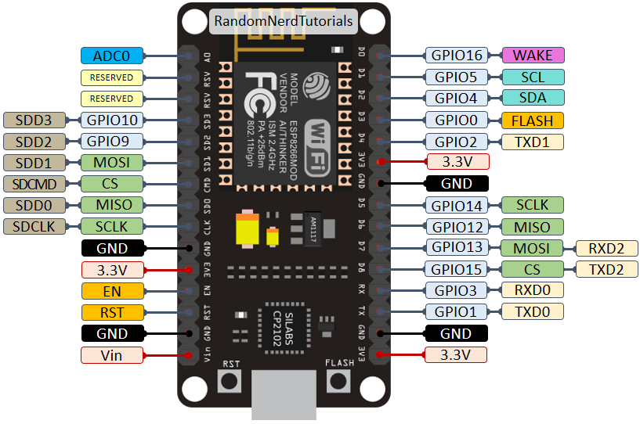
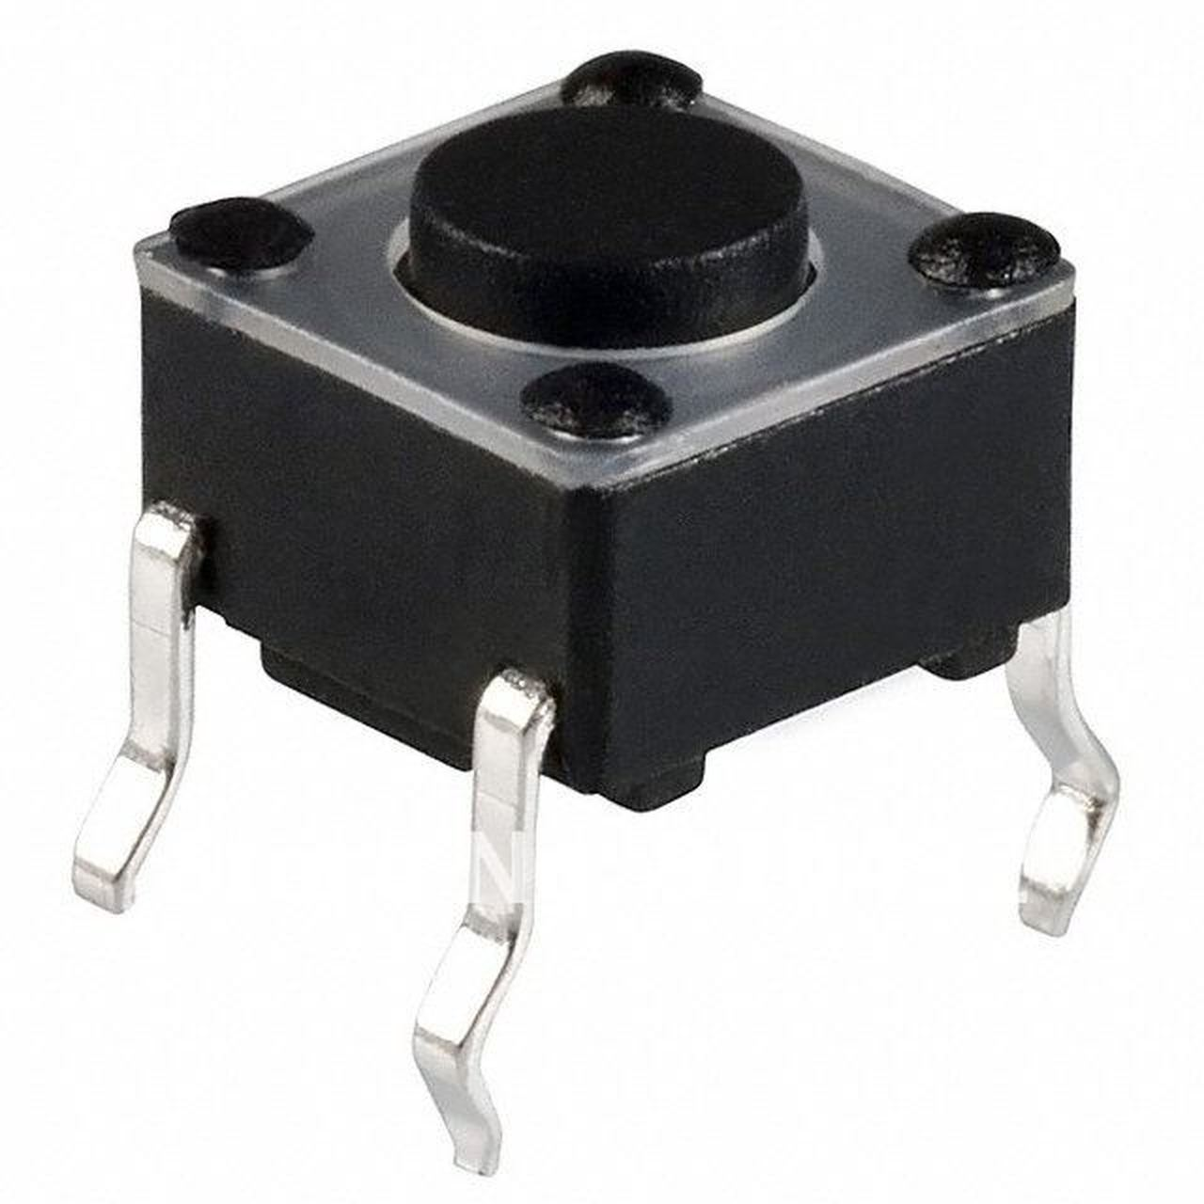
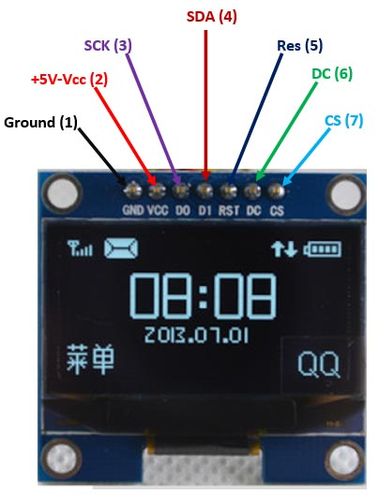
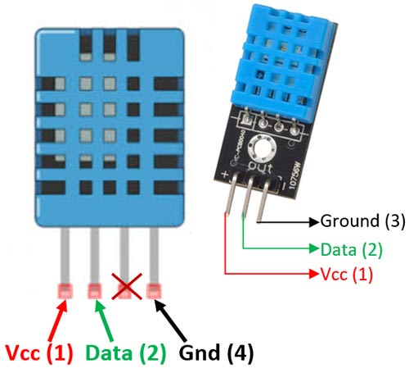
Hardware Required for this project are:-
NodeMCU
PIR SENSOR
PUSH BUTTON
OLED SCREEN
HUMIDITY SENSOR

Slide 9
NodeMCU:-
NodeMCU is a low-cost open source IoT platform.
It is the firmware for which open source prototyping board designs are available
The name “NodeMCU” combines “node” and “MCU” (Micro Controller Unit).

Slide 10
PIR SENSOR:-
PIR stands for Passive Infrared Sensor
IT measures infrared light radiating from objects in its field of view.
The term “passive” refers to the fact that PIR devices do not radiate energy for detection purposes
They work entirely by detecting infrared radiation emitted by or reflected from objects.

Slide 11
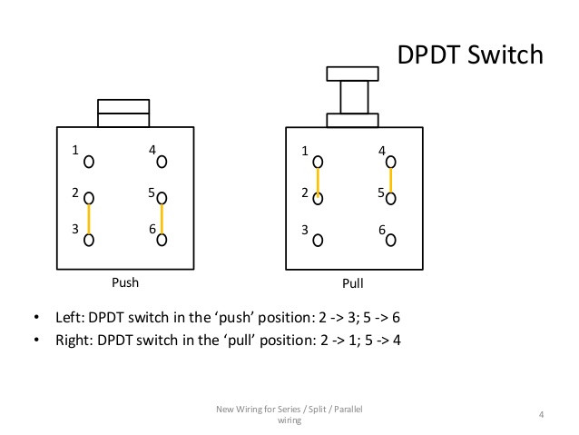
PUSH BUTTON :-
A push-button is a simple switch mechanism to control some aspect of a machine or a process.
The surface of the push button is usually flat or shaped to accommodate the human finger

Slide 12
OLED SCREEN:-
OLED Stands for "Organic Light Emitting Diode" and is pronounced "oh-led."
OLED is a type of flat screen display similar to an LCD that does not require a backlight.
Each LED within an OLED panel lights up individually.
Interfacing this IC with MCU can either be done using IIC or using SPI hence helps to save some pins as well.

Slide 13
HUMIDITY SENSOR:-
A humidity sensor (or hygrometer) senses, measures and reports both moisture and air temperature.
These sensors be divided into two groups: relative humidity (RH) sensors and absolute humidity (AH) sensors.
These sensors can also provide accurate measurements of dew point and absolute humidity

Slide 14

SOFTWARE REQUIREMENTS

Slide 15




Software Required for this project are:-
ARDUINO IDE
NODE-RED
MIT APP INVENTOR
IBM CLOUD

Slide 16
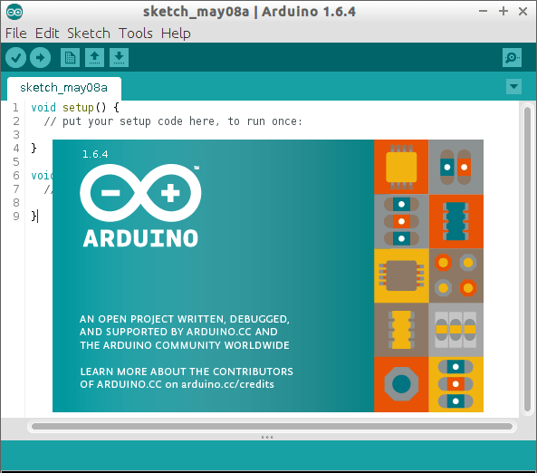
ARDUINO IDE
The Arduino Integrated Development Environment (IDE) is a cross platform application.
It is written in functions from C and C++.
It’s used to write and upload programs to Arduino compatible boards.

Slide 17
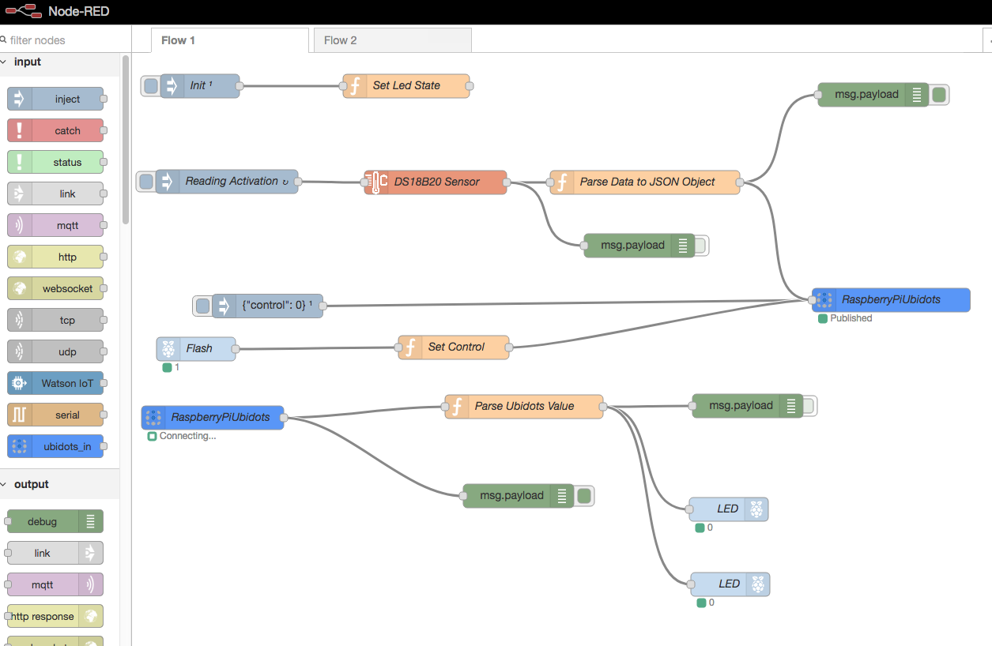
NODE-RED
Node-Red is a flow based development tool for visual programming
It is used for wiring together hardware devices, APIs and online services.
It provides a browser-based editor that makes it easy to wire together flows using the wide range of nodes

Slide 18
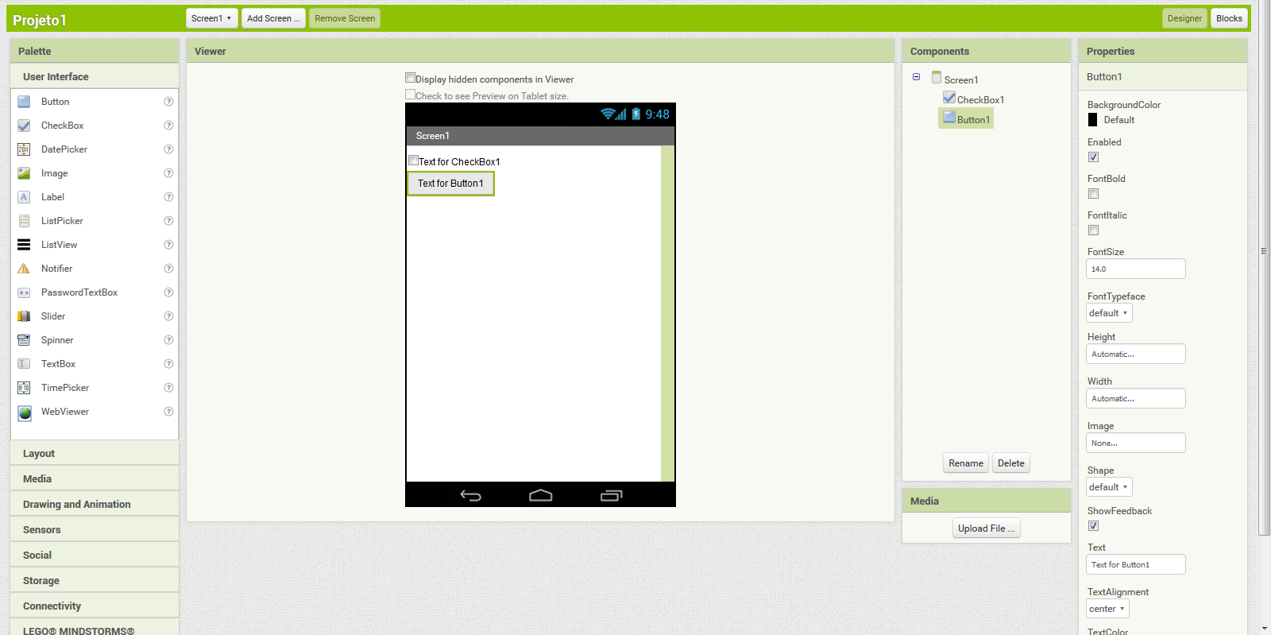
MIT APP INVENTOR
MIT App Inventor is a web application integrated development environment
It allows to create apps for two operating systems: Android and iOS.
It uses a GUI which allows users to drag and drop visual objects to create an application that can run on mobile devices.

Slide 19
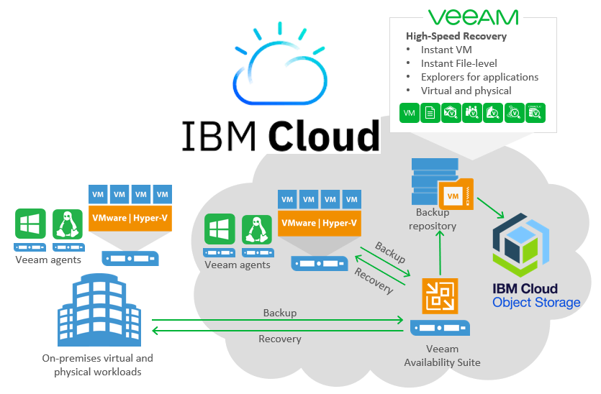
IBM CLOUD
IBM cloud computing is a set of cloud computing services for business offered by IBM.
It offers both platform as a service (PaaS) and infrastructure as a service (IaaS).
With IBM Cloud IaaS, organizations can deploy and access virtualized IT resources
With IBM Cloud PaaS developers can use IBM services to create, manage, run and deploy various types of applications for the public cloud, as well as for local or on-premises environments.

Slide 20
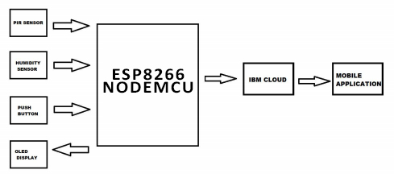
WORKING

Slide 21
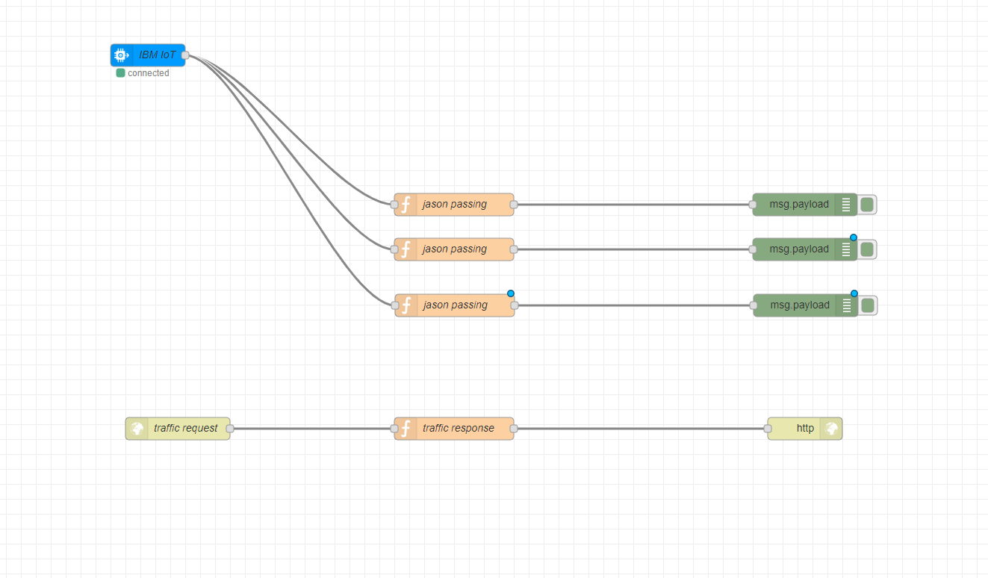
NODE-RED FLOW :
The NodeRed flow acts as a interface between the hardwere and the webpage which can be use to later to extract data onto the mobile application.

Slide 22
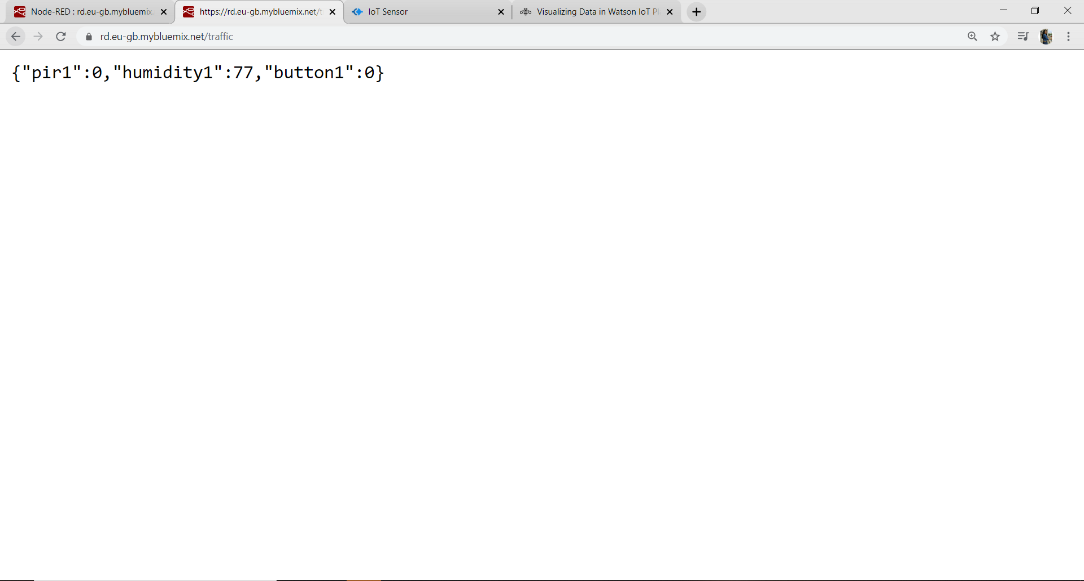
WEBPAGE:
Now, since we know that Node-Red provides a Web browser interface for flow editing , so the extracted readings will be displayed on the web page.
All the readings are then taken from the web page and then the readings are sent onto the mobile application

Slide 23
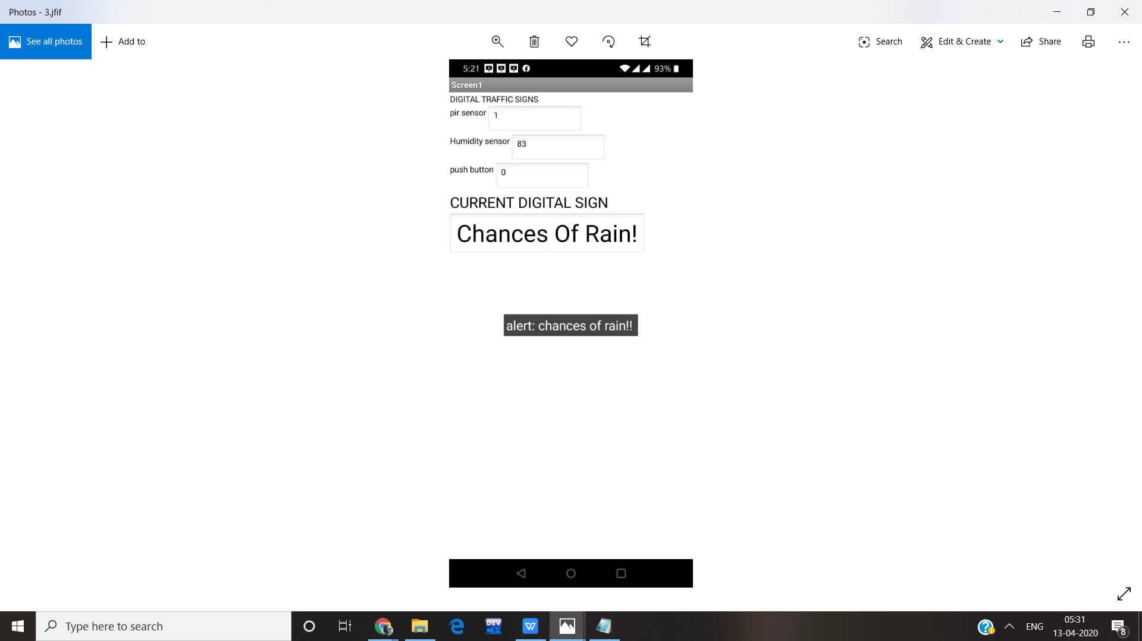
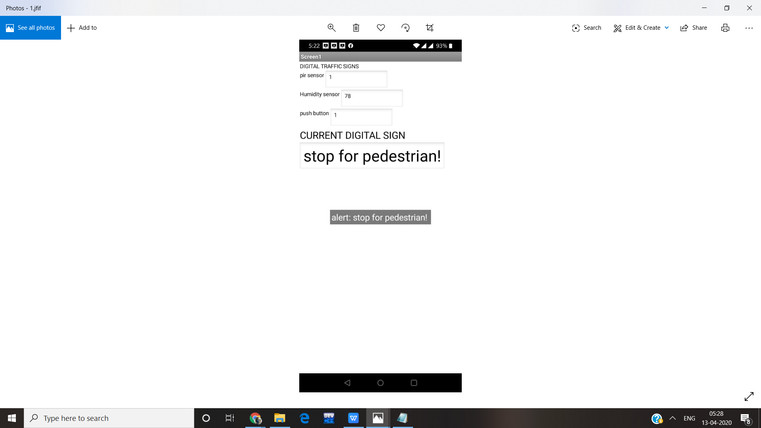
MOBILE APPLICATION :
In the first picture our mobile application shows the output as chances of rain! as our himidity sensor has detected that it is or will be raining.
In the second picture our mobile application shows the output as stop for pedestrian! as someone might have pressed the push button so they can cross the road while the taffic is stoped.

Slide 24

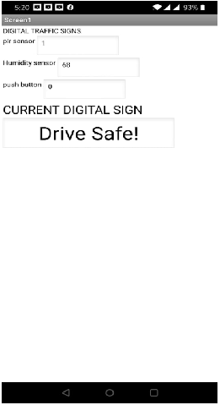
In the first picture our mobile application shows the output as Heavy traffic! as our PIR sensor has detected less movement.
In the second picture our mobile application shows the output as drive safe! as there is no obsticle and he/she can drive safely now.

Slide 25
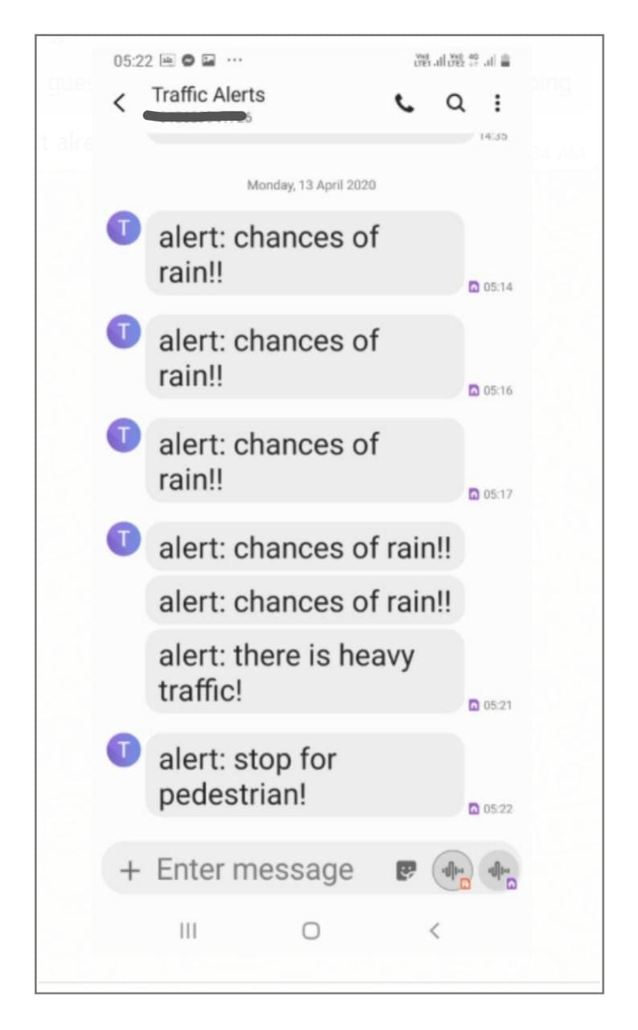
Message Alert:
We can also receive alert notifications via text messages using the app. which can be use to alert TRAFFIC POLICE COMMISSIONERATE to keep a check on what the sign board is displaying and if needed can send a traffic police to assist the situation.

Slide 26
FUTURE SCOPE
PREDICTS HEAVY TRAFFIC:- In order to avoid different kind of losses caused due to traffic, it is mandatory to take effective steps. One way to solve this is by predicting the high traffic density. Furthermore, the PIR sensor detects and informs the traffic control system about the traffic jam risk in order to guide them bypass critical zone.
CUSTOMIZE ROAD CROSSING TIME:- The other way discussed in project is about using push button to customize the time for pedestrians to cross the road according to available traffic which will save their time. This is helpful in urban areas with huge population on foot.

Slide 27
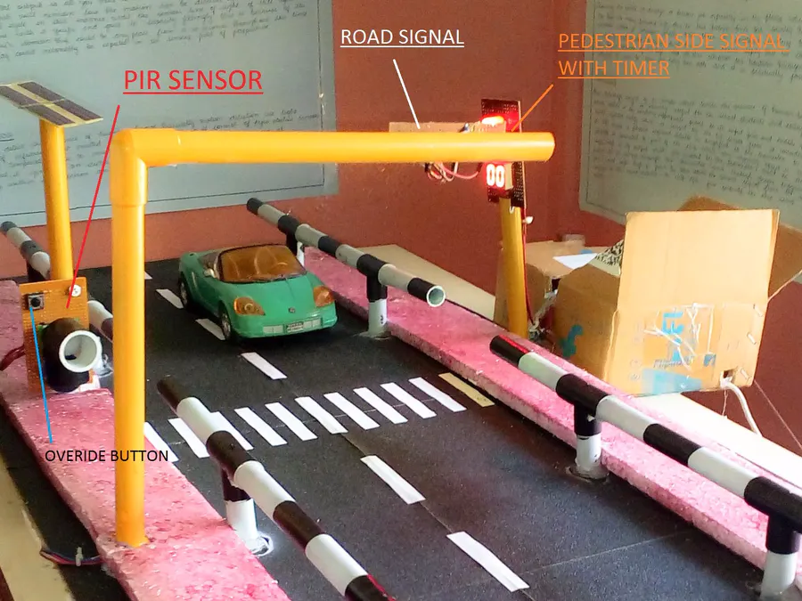
MEASURES HUMIDITY IN ATMOSPHERE
Next is humidity sensor which senses the humidity in atmosphere and predicts whether there is chances of rain or not. This can be very helpful to drivers as a large number of road accidents take place due to bad weather conditions. This informs driver to vary speed accordingly or take a divergence.

Slide 28
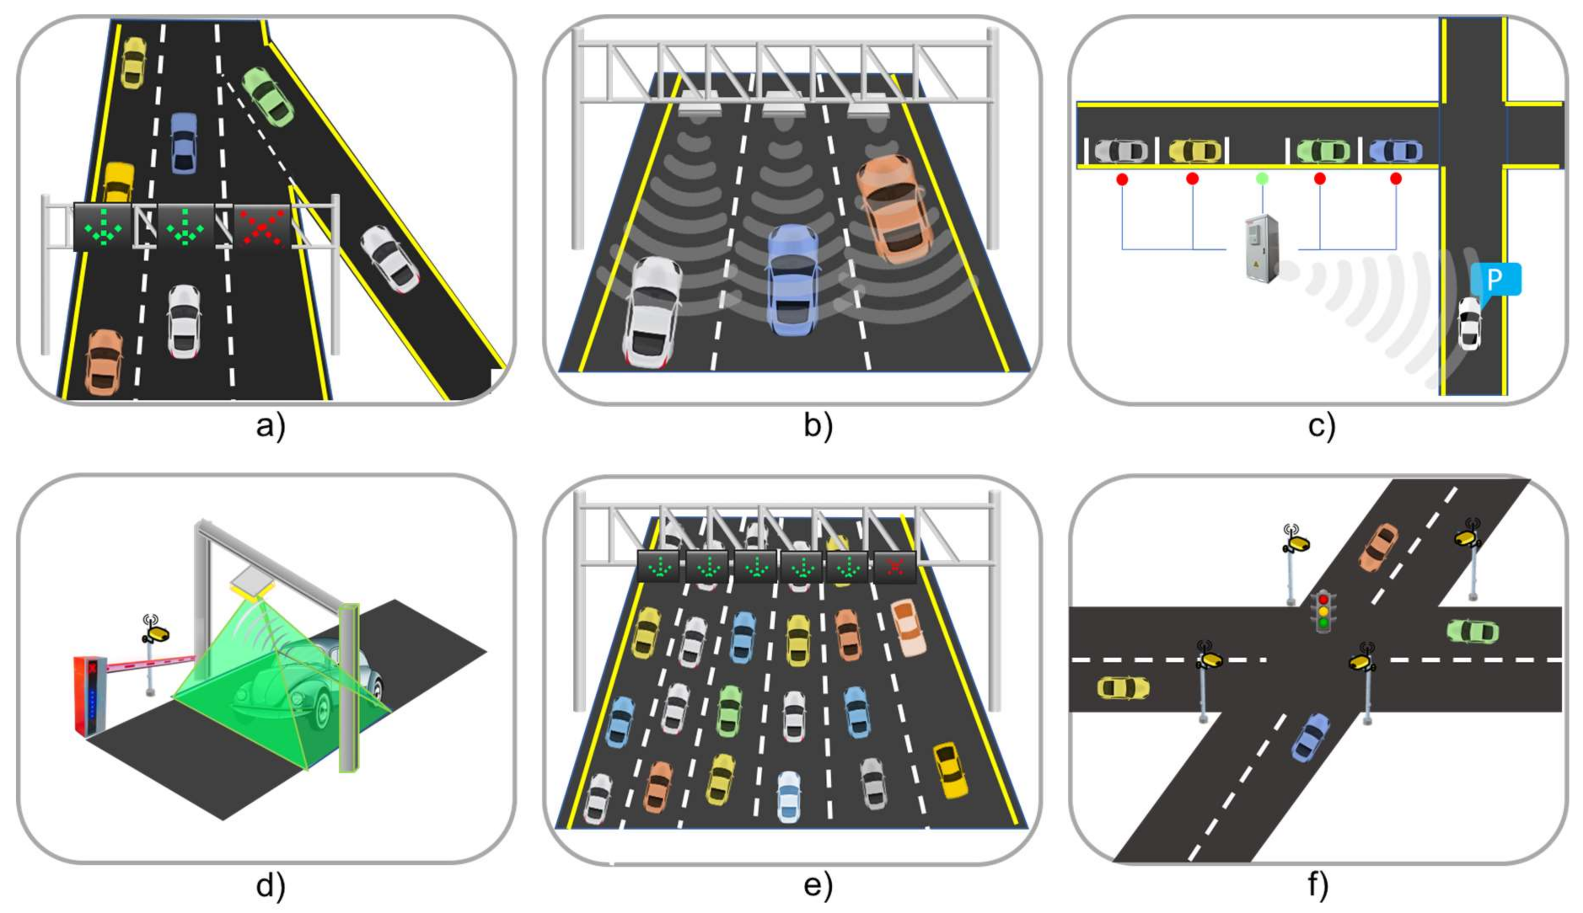
IMPROVES ROAD CAPACITY:- The project identifies the mixed traffic conditions and encroachment resulting in reduction of capacity of roads and providing the information to drivers to choose alternative routes.
SAVES TIME:- The project provides the current traffic condition to drivers which helps them to take an alternate route. The customized push button helps to save time for pedestrians.

Slide 29
CONCLUSION
The project aims to serve people different current road conditions through dynamic as well as static signs to make their best decisions and save time. Population growth and different traffic issues were among the parameters analyzed in the project to recommend suitable improvements for smoother traffic flows.

Slide 30
REFERENCES
http://watson-iot-sensor-simulator.mybluemix.net/
https://en.wikipedia.org/wiki/Internet_of_things
https://rd.eu-gb.mybluemix.net/red/
https://en.wikipedia.org/wiki/Node-RED
https://en.wikipedia.org/wiki/NodeMCU
https://en.wikipedia.org/wiki/IBM

Slide 31
THANK YOU

